Slide 1
Customer Segmentation Analysis
Data Analytics for Automobile Bike Company
Lomash Bhuva

Slide 2
Presentation Index
Introduction
Dataset Overview
Methodology
Dataset & Tools Technologies
Key Findings
Expected Outcomes
Conclusion

Slide 3
Introduction

Slide 4
Introduction
Project Title:
Customer Segmentation Analysis for Automobile Bike Company
Objective:
Enhancing marketing strategies and sales through data-driven insights.
Importance:
Understanding customer behavior to optimize business decisions.

Slide 5
Project Description:
The project focuses on conducting a Customer Segmentation Analysis for the Automobile Bike Company. Customer segmentation involves dividing customers into groups based on shared characteristics such as purchasing behavior, demographics, and preferences. By analyzing these segments, businesses can tailor their marketing strategies and improve customer engagement effectively.
Goal of the Project
The purpose of this project is to conduct a Customer Segmentation Analysis for an Automobile bike Company. Customer segmentation is performed by developing a RFM Model. RFM (Recency, Frequency, Monetary) analysis is a behavior-based approach grouping customers into segments. It groups the customers on the basis of their previous purchase transactions. In this analysis the customer segment was divided into 11 groups. The analysis will help in determining which customers segments should be targeted in order to enhance sales revenue for the company. A Sales Dashboard for Customer
Segmentation is developed using Tableau and the data quality assessment and analysis is done using Python.

Slide 6
Dataset Overview

Slide 7
Dataset Overview
The dataset used in this project encompasses various facets of customer and operational data collected by the Automobile Bike Company. It includes:
Sales Records: Information about customer purchases, including product details, transaction dates, and purchase amounts.
Customer Demographics: Data such as age, gender, occupation, and income levels of customers.
Transaction Histories: Records detailing the frequency and types of transactions made by each customer over a specified period.
Customer Addresses: Geographic information including state or region, which can provide insights into regional preferences and behaviors.

Slide 8
Importance of Data Cleaning and Preparation
Before analysis, the dataset undergoes rigorous cleaning and preparation to ensure accuracy and consistency. This process involves:
Handling Missing Values: Addressing gaps in the data by either imputing values or removing incomplete records to prevent skewed analysis.
Standardizing Formats: Ensuring uniformity in data formats (e.g., dates, gender categories) to facilitate seamless analysis across different datasets.
Removing Irrelevant Data: Eliminating unnecessary or redundant information that does not contribute to the analysis objectives.

Slide 9
Role of Dataset in Customer Segmentation
The dataset serves as the foundation for customer segmentation analysis. By integrating and analyzing these diverse data points, the project aims to uncover meaningful patterns and insights into customer behavior. These insights will inform segmentation strategies that enable targeted marketing initiatives, personalized customer experiences, and strategic business decisions aimed at maximizing customer satisfaction and business growth.

Slide 10
Methodologies

Slide 11
Methodologies Overview
1. Data Quality Assessment and Data Cleaning
Ensure the dataset is accurate and reliable for analysis by addressing issues like missing data, inconsistencies, and outliers.
2. Exploratory Data Analysis on Customer Segments
Explore and understand customer behavior through visual and statistical analysis of the dataset.
3. RFM Analysis and Customer Segmentation
Segment customers based on their transactional behavior using the RFM model (Recency, Frequency, Monetary).
4. RFM Analysis: Scatter Plots
Visualize relationships between RFM metrics to identify patterns and segment characteristics.

Slide 12
Data Quality Assessment and Data Cleaning
Objective:
Ensure the dataset is accurate and reliable for analysis by addressing issues like missing data, inconsistencies, and outliers.
Process:
Identify Missing Data: Determine where data is missing and decide whether to impute values or remove incomplete records.
Handle Inconsistencies: Standardize data formats (e.g., date formats, categorical variables) for uniformity.
Remove Outliers: Address data points that significantly deviate from the norm and could skew analysis results.
Importance:
Clean data ensures the integrity of insights drawn from subsequent analysis steps, reducing errors and biases.

Slide 13
Data Quality Assessment and Data Cleaning
The first step towards generating useful insights from the data was the data preparation, quality assessment and data cleaning step. After the cleaning process exploratory data analysis on the dataset and identification customer purchasing behaviours to generate insights can be performed.
In the data cleaning step the data quality of the following datasets were first assessed. After a data quality assessment the following data quality issues was observed and the necessary process to mitigate the issue was followed :
CustomerDemographics.xlsx :
1 Irrelevant column was present and such columns were dropped from the dataset.
There were 5 columns were Missing values were present. For such columns based on the volume of the missing values either the records were dropped or appropriate values were imputed at places of missing values
For gender column there was no standardisation of data. Based on the values available the column data was standardised to remove data inconsistency.
The Date of Birth column was transformed to create a new feature column 'Age' and 'Age Group' to check for discrepancy of age distribution. An outlier was observed and the record was removed.
Checked whether there are duplicate records present in the dataset. In this dataset there were no duplicate records.

Slide 14
Data Quality Assessment and Data Cleaning
NewCustomerList.xlsx :
5 Irrelevent column was present and such columns were dropped from the dataset.
There were 4 columns were Missing values were present. For such columns based on the volume of the missing values either the records were dropped or appropriate values were imputed at places of missing values
The Date of Birth column was transformed to create a new feature column 'Age' and 'Age Group' to check for discrepancy of age distribution. There was no data inconsistency.
Checked whether there are duplicate records present in the dataset. In this dataset there were no duplicate records.
Transaction_data.xlsx :
The product_first_sold_date column is not in datetime format. The data type of this column was changed from int64 to datetime format.
There were 7 columns were Missing values were present. For such columns based on the volume of the missing values either the records were dropped or appropriate values were imputed at places of missing values
A new feature column 'Profit' was created which is basically the difference between list price and standard price. There was no data inconsistency.
Checked whether there are duplicate records present in the dataset. In this dataset there were no duplicate records.

Slide 15
Data Quality Assessment and Data Cleaning
CustomerAddress.xlsx :
For states column there was no standardisation of data. Based on the values available the column data was standardised to remove data inconsistency.
There were certain customer IDs from Customer Demographics table which were getting dropped in the Address table.

Slide 16
Exploratory Data Analysis (EDA) on Customer Segments
Objective:
Explore and understand customer behavior through visual and statistical analysis of the dataset.
Approach:
Visualizations: Use charts, graphs, and histograms to visualize distributions, correlations, and trends within customer segments.
Descriptive Statistics: Calculate measures such as mean, median, and standard deviation to summarize data characteristics.
Segment Profiling: Identify key customer segments based on demographic, behavioral, and transactional attributes.
Insights:
Gain initial insights into customer preferences, purchasing patterns, and segment characteristics that can inform further analysis and strategy development.

Slide 17
Exploratory Data Analysis (EDA) on Customer Segments
After the data cleaning process, exploratory analysis on the dataset is performed and the following insights are obtained :
New vs Old Customers Age Distribution
Most New customers are aged between 40-49 also for Old Customers the most of them are aged between 40-49
The lowest number of customers for both the types of customers is present in the age bracket under 20 and above 80 age groups.
The automobile company is popular among New Customers among the age groups 20-29 and 40-49.
A steep drop in customers is observed in the 30-39 age group among the New Customers

Slide 18
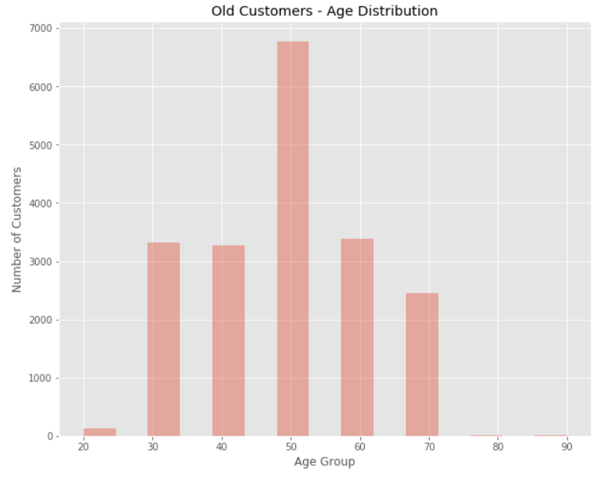
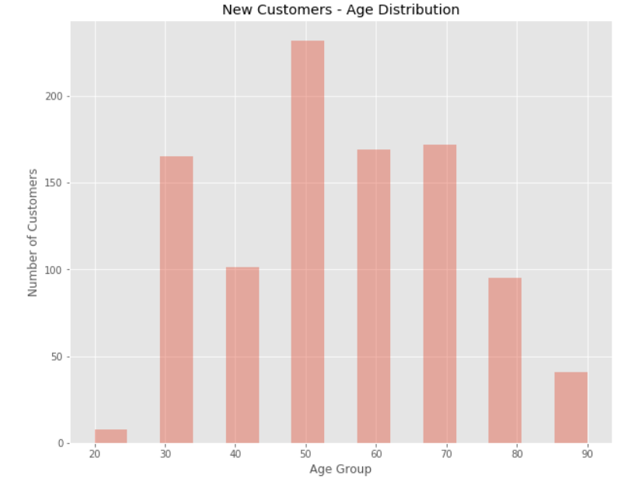
Exploratory Data Analysis (EDA) on Customer Segments
Old Customers by Age Distribution | New Customers by Age Distribution

Slide 19
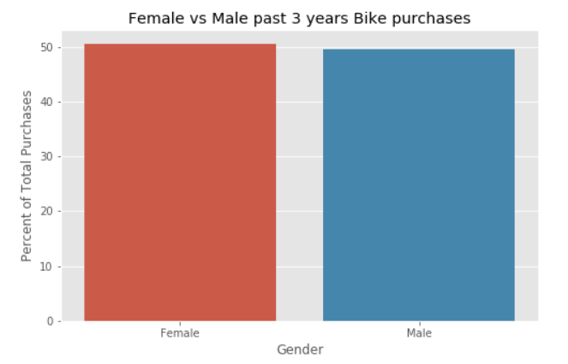
Exploratory Data Analysis (EDA) on Customer Segments
Bike purchases over last 3 years by Gender
Most bike purchases are done by Female over the last 3 years. Approximately 51% of the bike purchases are done by Female compared to 49% of the purchases being done by Male.
The Female purchases are 10,000 more than that of Male purchases (numerically).

Slide 20
Exploratory Data Analysis (EDA) on Customer Segments
New vs Old Customers Job Industry Distribution
Most New customers are from the Manufacturing and Financial Services sector (approx 20% of the New Customers).
The lowest number of customers are from the Agriculture and Telecom sector approx 3%.
Similar trend is observed among Old Customers as well.
Wealth Segmentation by Age Category
Across all age categories the largest number of customers are from 'Mass Customer' Segment
The next category comes from the 'High Net Worth' customers.
In the age group 40-49, Affluent segment out performs the High Net Worth customers in terms of number of customers.

Slide 21
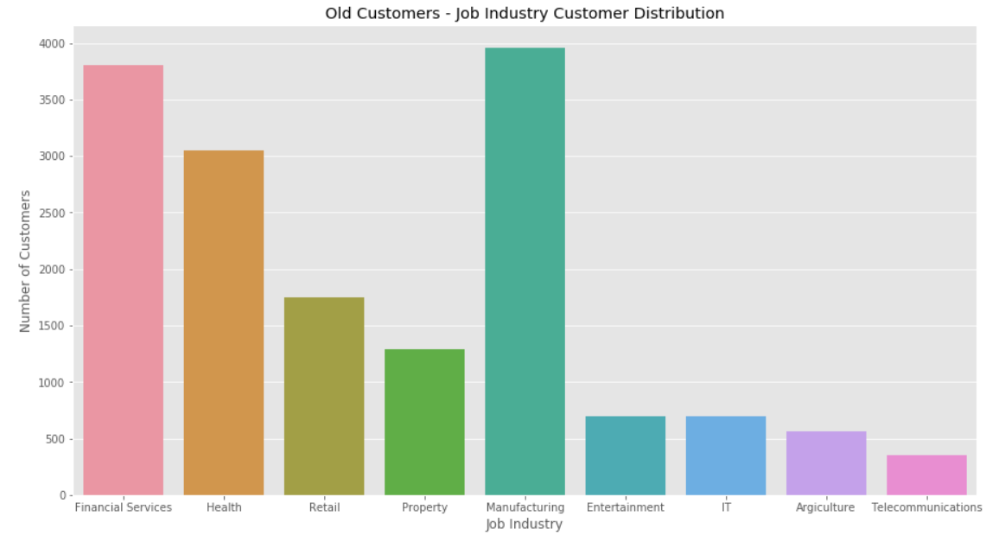
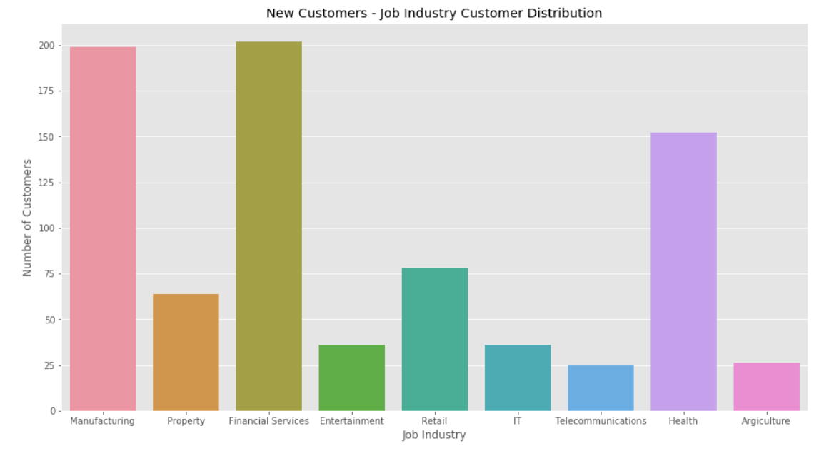
Exploratory Data Analysis (EDA) on Customer Segments
Old Customers by Job Industry | New Customers by Job Industry

Slide 22
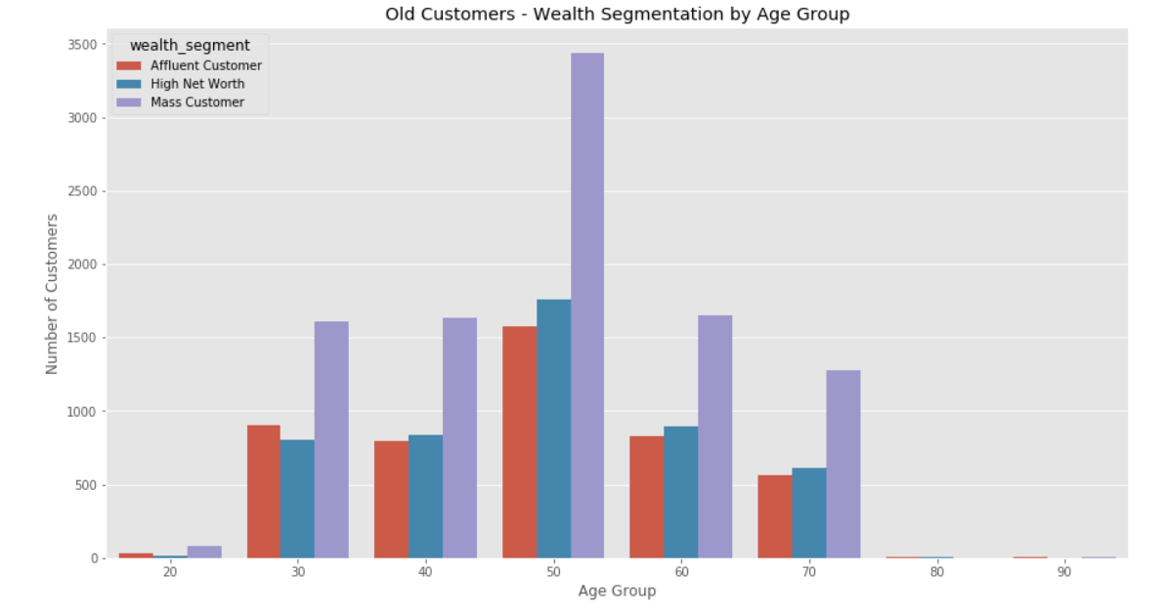
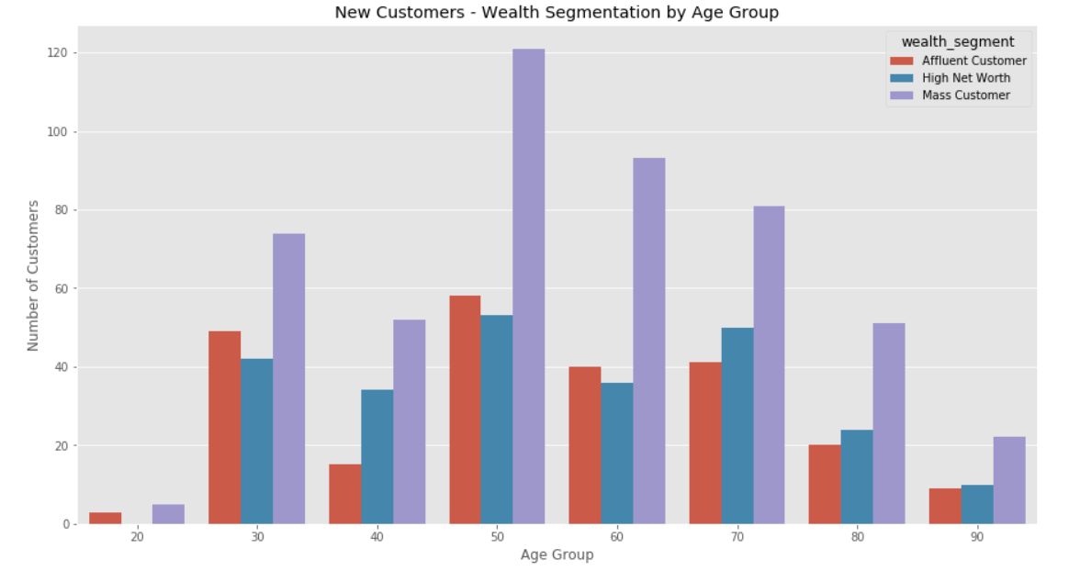
Exploratory Data Analysis (EDA) on Customer Segments
Old Customers by Age Group | New Customers by Age Group

Slide 23
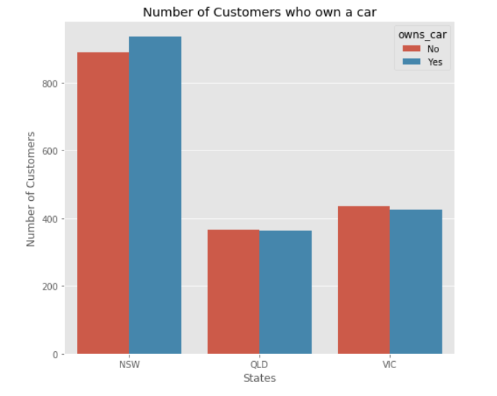
Exploratory Data Analysis (EDA) on Customer Segments
Cars owned by States
New South Wales has the largest number of people who don't own a car.
In Victoria the proportion is quite even.
In Queensland the number of people owning a car is greater than who don't have a car.

Slide 24
RFM Analysis and Customer Segmentation
Objective:
Segment customers based on their transactional behavior using the RFM model (Recency, Frequency, Monetary).
RFM Model Components:
Recency: How recently a customer made a purchase.
Frequency: How often a customer makes purchases.
Monetary: How much money a customer spends on purchases.
Segmentation:
Classify customers into groups (e.g., high-value, loyal, at-risk) based on RFM scores to tailor marketing and retention strategies.
Benefits:
Helps prioritize customer engagement strategies and allocate resources effectively by focusing on high-potential segments.

Slide 25
RFM Analysis and Customer Segmentation
In this stage of analysis the customer segmentation was done by developing an RFM Model. The RFM (Recency, Frequency, Monetary) analysis is a behavior-based approach grouping customers into segments. It groups the customers on the basis of their previous purchase transactions.
In this analysis the customer segment was divided into 11 groups. The groups being :
Platinum Customers
Very Loyal Customers
Recent Customers
Potential Customers
Lost Customers
Losing Customers
Late Bloomer
High Risk Customers
Evasive Customers
Becoming Loyal
Almost lost Customers

Slide 26
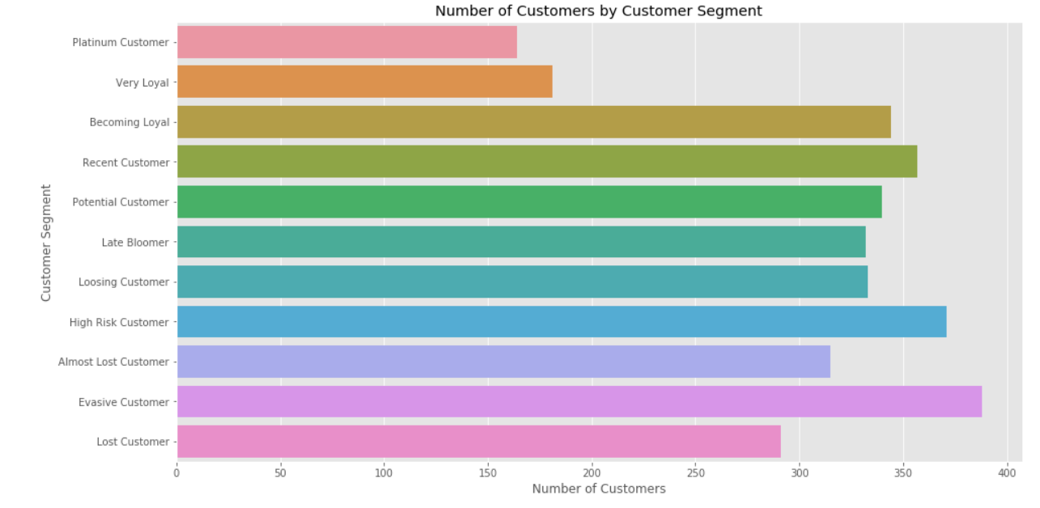
RFM Analysis and Customer Segmentation
As of the current state of the Automobile business the current distribution of customers segments is depicted below:

Slide 27
RFM Analysis: Scatter Plots
Objective:
Visualize relationships between RFM metrics to identify patterns and segment characteristics.
Visualization:
Recency vs. Monetary: Scatter plot showing how recent purchases correlate with monetary value, indicating spending behavior.
Frequency vs. Monetary: Scatter plot illustrating the relationship between purchase frequency and monetary value, highlighting loyal customers and potential spenders.
Insights:
Insights derived from scatter plots help in understanding customer segments more intuitively, guiding targeted marketing efforts and personalized customer interactions.

Slide 28
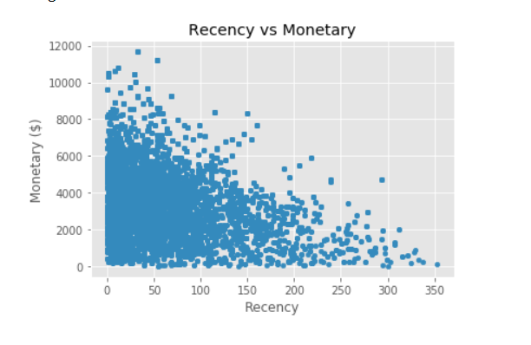
RFM Analysis: Scatter Plots
Recency vs Monetary :
The visualization shows that recent customers have purchased more products and generated relatively more revenue than the customers who visited a while ago.

Slide 29
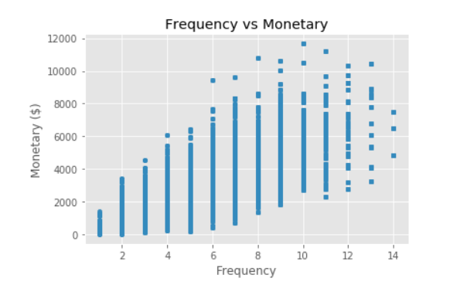
RFM Analysis: Scatter Plots
Frequency vs Monetary :
The visualization shows that customers belonging to Platinum/ Very Loyal/ Becoming Loyal Customer Segments have a greater frequency and generate greater monetary for the business

Slide 30
Datasets
Tools & Technologies

Slide 31
Datasets Used
The datasets used include:
Raw_data.xlsx: This excel file dataset included the following sheets of data:
Transactions_data.xlsx: This dataset included the transactions data of the customers across all the different states in Australia.
NewCustomerList.xlsx: This dataset included the new customers who visted the automobile bike company recently.
CustomerDemographic.xlsx: This dataset included entire details of the Customer Demographics.
CustomerAddress.xlsx: This dataset included the address of the Customers.

Slide 32
Tools and Technologies
The tools used in this project include:
Python - This was needed to conduct Data Quality Assessment and also for Data Cleaning processes. With Python libraries pandas, matplotlib, seaborn exploratory data analysis of the datasets and to gain useful insights from the data was possible.
Tableau - This Business Intelligence tool was required to explore data and create charts, graphs, visualizations to come up with a Sales Dashboard for Customer Segmentation for the automobile bike company. The Tableau Sales Dashboard can be found here.
Link to TableAU Dashboard

Slide 33
Key Findings

Slide 34
Key Findings
Segment Identification: Identified distinct customer segments (e.g., high-value, loyal, at-risk) using RFM analysis.
Demographic Insights: Discovered significant age and income trends among segments, informing targeted marketing efforts.
Behavioral Patterns: Uncovered purchasing behaviors, seasonality trends, and product preferences across segments.
Customer Lifetime Value (CLV): Calculated CLV to prioritize resources and retention strategies for high-value segments.
Predictive Analytics: Forecasted future behaviors like churn risk and upsell opportunities to guide proactive measures.
Geographic Variations: Analyzed regional data to tailor marketing strategies and enhance market penetration.

Slide 35
Expected Outcomes

Slide 36
Expected Outcomes
Enhanced Marketing Strategies:
Develop targeted marketing campaigns tailored to specific customer segments, increasing engagement and conversion rates.
Improved Customer Retention:
Implement strategies to strengthen relationships with high-value and loyal customers, reducing churn and enhancing lifetime value.
Optimized Resource Allocation:
Allocate marketing and sales resources more effectively by focusing on high-potential segments, improving ROI and operational efficiency.

Slide 37
Expected Outcomes
Personalized Customer Experience:
Create personalized experiences and offers based on customer preferences and behaviors, boosting satisfaction and loyalty.
Informed Business Decisions:
Provide actionable insights and data-driven recommendations to support strategic planning and decision-making processes.
Increased Revenue Growth:
Leverage insights to identify upsell and cross-sell opportunities, driving revenue growth and expanding market share.

Slide 38
Conclusion

Slide 39
Conclusion
The Customer Segmentation Analysis for the Automobile Bike Company has successfully identified key customer segments and uncovered valuable insights into their behaviors and preferences. By implementing data-driven strategies, the company is poised to enhance its marketing effectiveness, improve customer retention, and boost overall revenue. The project’s findings will enable the company to deliver more personalized customer experiences, optimize resource allocation, and make informed business decisions, ultimately securing a competitive edge in the market.

Slide 40
Thank You.

